Slide 1
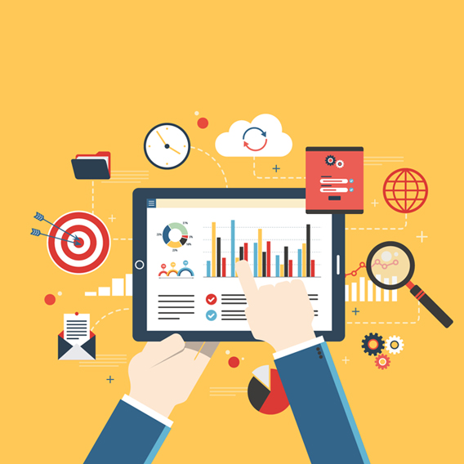
Introduction to Real time Analytics

Slide 2
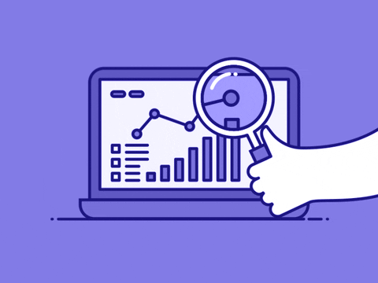

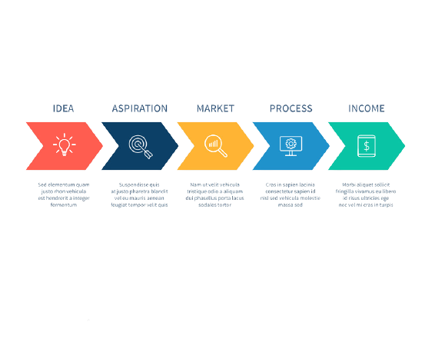


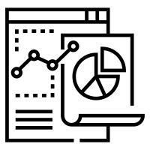


Data Analytics is the process by which businesses/organizations use statistical methods and technologies for analyzing historical data in order to gain new insight and improve strategic decision-making and also make predictions.
Data Collection
Data Cleaning
Data Analysis
Data Deployment

Slide 3
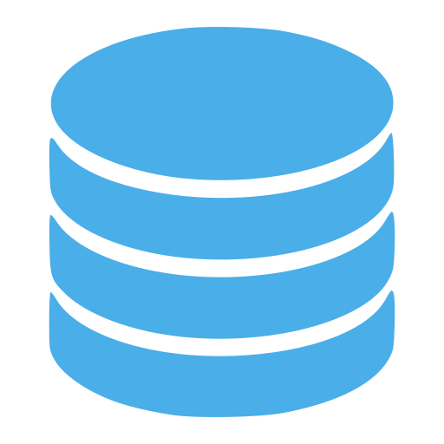







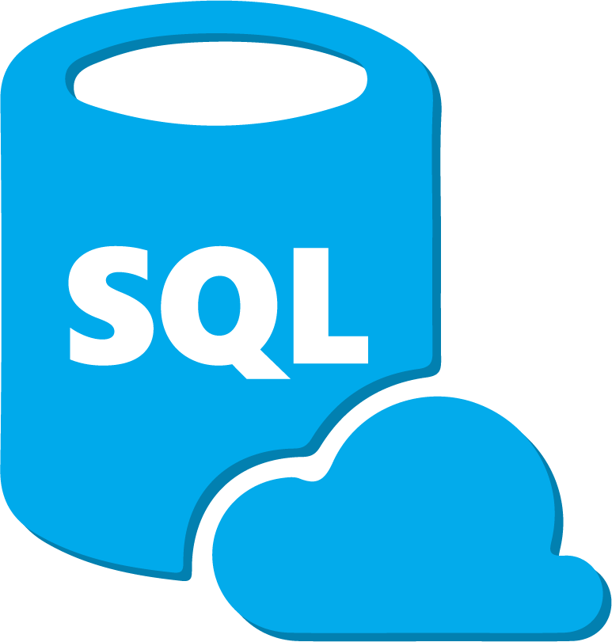
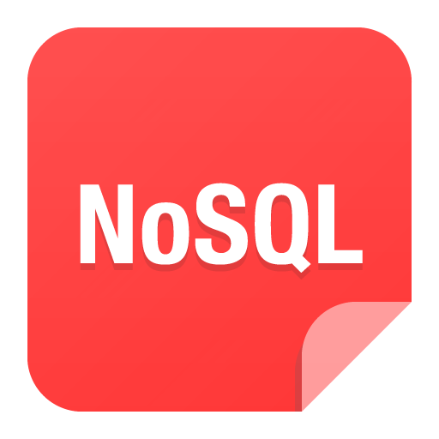
Data Collection
Data Collection Methods
Storing Data on Database
Database Options
Choosing a Database
Big Data Database
Surveys
A survey consists of a list of queries respondents can answer in just one or two words and often gives participants a list of responses to choose from. You can use them to collect either quantitative or qualitative data or both. You can conduct surveys online, over email, over the phone or in person.
Choice is dependent on:
Type of study
How will you collect data
Local language requirement
Planned use of data
Size of study
Budget
What functionality do you require of the database
• Ranging from the free Open Source solutions through to the high end “Software as a Service” (SaaS)
• Open-source software (OSS) is computer software with its source code made available for anyone to study, change and distribute the software for any purpose.
• Software as a Service (SaaS), a licensing and delivery model in which software is licensed on a subscription basis and is centrally hosted by the software vendor
Big Data is a Database that is different and advanced from the standard database. BigData is the type of data that includes unstructured and semi-structured data. There are specific types of database known as NoSQL databases, There are several types of NoSQL Databases and tools available to store and process the Big Data. NoSQL Databases are optimized for data analytics using the BigData such as text, images, logos, and other data formats such as XML, JSON. The big data is helpful for developing data-driven intelligent applications.
Online Tracking
Your business’ website, and your app, are excellent tools for collecting customer data. When someone visits your website, they create as many as 40 data points. Accessing this data allows you to see how many people visited your site, how long they were on it, what they clicked on and more. You can use tools like pixel, lotame to access and analyze these data.
Data storing format

Slide 4


Data Collection
Why use a Database
instead of Spreadsheets?
Ensuring Storage and security of Data
More than one person can update a database at a time
A database stores information more efficiently
Queries, and the reports based on those queries, are easier to write and run
In a database, data is stored separately to the application. If the application crashes it will affect all the data in the spreadsheet
Data recovery is more efficient
Data is secure and centrally located
• All data stored on secured servers
• Password protected files with restricted access to study personnel
• All data is regularly backed up
• Servers are maintained to monitor and ensure efficient performance
• Software is maintained and new versions rolled out effectively and securely
• Disaster recovery databases for all databases
Types of Database
NoSQL Database
Non-SQL/Not Only SQL is a type of database that is used for storing a wide range of data sets. It is not a relational database as it stores data not only in tabular form but in several different ways. It came into existence when the demand for building modern applications increased. Thus, NoSQL presented a wide variety of database technologies.
Centralized Database
It is the type of database that stores data at a centralized database system. It comforts the users to access the stored data from different locations through several applications. These applications contain the authentication process to let users access data securely.
Distributed Database
Unlike a centralized database system, in distributed systems, data is distributed among different database systems of an organization. These database systems are connected via communication links. Such links help the end-users to access the data easily.
Relational Database
This database is based on the relational data model, which stores data in the form of rows & columns, and together forms a table. A relational database uses SQL for storing, manipulating, as well as maintaining the data. Each table in the database carries a key that makes the data unique from others. Examples: MySQL, Microsoft SQL Server, Oracle, etc.

Slide 5
What is Business Intelligence?
It’s a process
It’s not a single, specific tool
It’s a variety of resources including
Spreadsheet and random notes as well as:
Advanced technology is used to analyze and refine large amounts of data
It takes that data to make informed decision
Business Leaders and decision makers can use
those conclusions to make informed business decision
Hardware
Software
Applications
Techniques
Business intelligence exists because there is an incredible amount of data available to businesses.
They can use this data to learn and be more efficient.
Business Intelligence
Bring all the data
together
Discover Patterns
Interpret the data

Slide 6
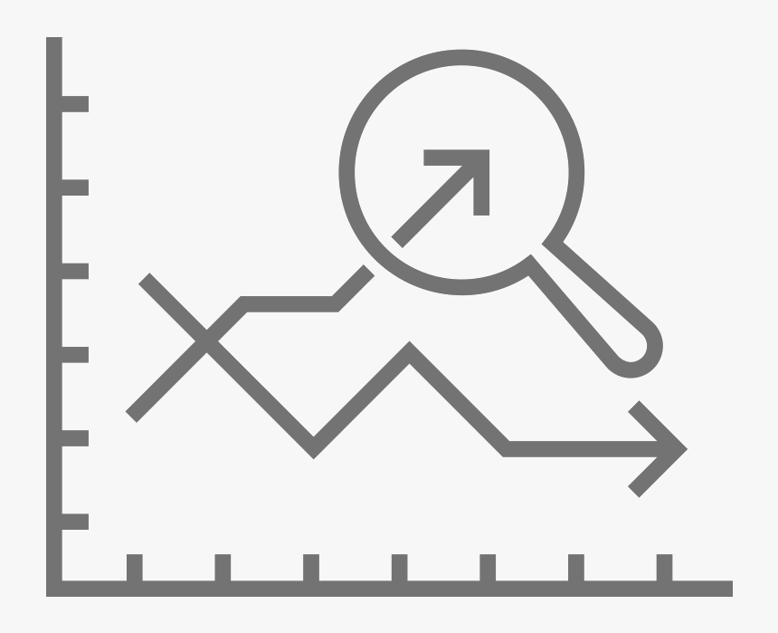
Difference between BI and BA
What business Intelligence doesn’t do
It doesn’t focus on
the future
It’s used to create a
Reactive response
BI teams generally oversee
Straightforward querying and analysis
of business data
Business Analytics (BA) uses data to identify and review past business trends in order
To predict future trends
Advance analytics is the examination of data using sophisticated tools, typically
Beyond those of tradition BI, allowing for deeper insights of predictions to be made
Advance
Analytics
Augmented
Analytics

Slide 7
The process
BI is the act of transforming raw/ operational data into useful information for business analysis
How does it work?
1. BI based on Data Warehouse technology extracts information from a company’s operational systems.
2. The data is transformed (cleaned and integrated), and loaded into Data Warehouse.
3. Since this data is credible, it is used for business insights
DB 1
Data Warehouse
DB 2

Slide 8
The process
Data collected from various sources and stored in various databases cannot be directly visualized
Extract, Transform, Load
Data Warehouse
ETL

Slide 9
The Data Warehouse process
CRM
Meta Data
Analysis
User Access
Data Warehouse
Kolkata plant resource plan
BI Tools
ERP
Information portal
Reporting tool
Data Warehouse
Sales
Dashboards
Trade
ETL
+
Predictive Layer
Machine Learning
SCM
Data Mart
External
Notes:
Extract, Transform & Load

Slide 10
Inside of Warehouse
Relational Database: Microsoft SQL Server, SAP, Oracle and IBM BD2, AWS RD
Metadata
Analytical Database: Teradata, Greenplum
Data Warehouse Database: SAP Hana, Oracle Exadata, IBM Netezza
Summary
Data
Raw Data
Cloud-based Database: AWS, Azure SQL, Google Big query

Slide 11
Data transformation
A customer – 335 BDT (string)
B customer – 400 BDT (string)
A+B (combined) = 335+400= 335400
ERP -> on which date my kishorganj inventory received a particular product
Timestmp | Date (DD-MM-YYYY) | Product Name | Product Grade
<> | 28-01-2021 | Metal | 123M4 (character)
<> | 21-02-2021 | Steel | 54212.(character)

Slide 12
Meta Data
Map of our data warehouse
Meta_data_category = data_table_name
Metadata in a data warehouse defines as objects
ID:Region-Kolkata
ID:Date_received- 05-06-2021
ID == Coutry,Date_recieved
Filter(in Country == Kolkata & date_received ==”05-06-2021”
Extracted : 725 datasets

Slide 13
Inside of Warehouse
Metadata can hold these information:
- Source for any extracted data
Use of that DW data
Features of data
Transformation logic for extracted data
DW tables and their attributes
DW objects
Timestamps
Types of Metadata:
- Backroom Metadata
– Front room Metadata
- Process Metadata
Metadata works as an index to all the DW contents

Slide 14
Data Pipeline
Data Pipeline is a series of data processing steps. It’s the next generation solution instead of ETL. It consists of three key elements: a source, a processing step or steps, and a destination.
Data Pipeline vs ETL
Basic Data Pipeline Architecture
ETL refers to a specific type of data pipeline. It stands for “extract, transform & load”. It is a process of moving data from a source, such as an application to a data warehouse. And data pipeline is all set of process to perform analytics and it’s not mandatory data pipeline to involve transformation.
Data
Operation 1
Operation 2
Operation 3
Data
Data source (could be relational or non-relational database)
Transformation, processing & workflow
Destination of data(Data Warehouse)

Slide 15
Data Pipeline (Streaming Architecture)
In Data Processing there are two ingestion models: batch processing, in which source data is collected periodically and sent to the destination system, and stream stream processing, in which data is sourced, manipulated, and loaded as soon as it’s created.
Streaming Data Pipeline Architecture
Stream Processing App 1
Stream Processing App 2
Stream Processing App 3
Analytical Database
Delivery Apps
Data sources
Streaming Platform
Dashboard Alerts
Archive Database
This diagram models a streaming data pipeline. The data stream is managed by the stream processing framework where it can processed and delivered to apps and/or solution

Slide 16
Data Pipeline (Lambda Architecture)
In Data Processing there are two ingestion models: batch processing, in which source data is collected periodically and sent to the destination system, and stream stream processing, in which data is sourced, manipulated, and loaded as soon as it’s created.
Lambda Data Pipeline Architecture
Batch Layer
Serving Layer
Master Data
Batch view 1
Query
view 2
Data sources
view N
Speed Layer
Real-time View
From T0 to T1
Real-time View
From T1 to TN
The Lamda Architecture accounts for both a traditional batch data pipeline and a real time data streaming pipeline. It also has a serving layer that responds to queries.

Slide 17


Top ETL tools for 2021
Workflow management System (WMS)
Data Processing
ETL framework
Bonobo
Mara

Slide 18
The Message broker/Stream Processor
Apache kafka, Amazon Kinesis Data Streams
Batch and Real Time ETL Tools
Data Analytics/ Serverless Query Engine
Streaming Data Storage

Slide 19
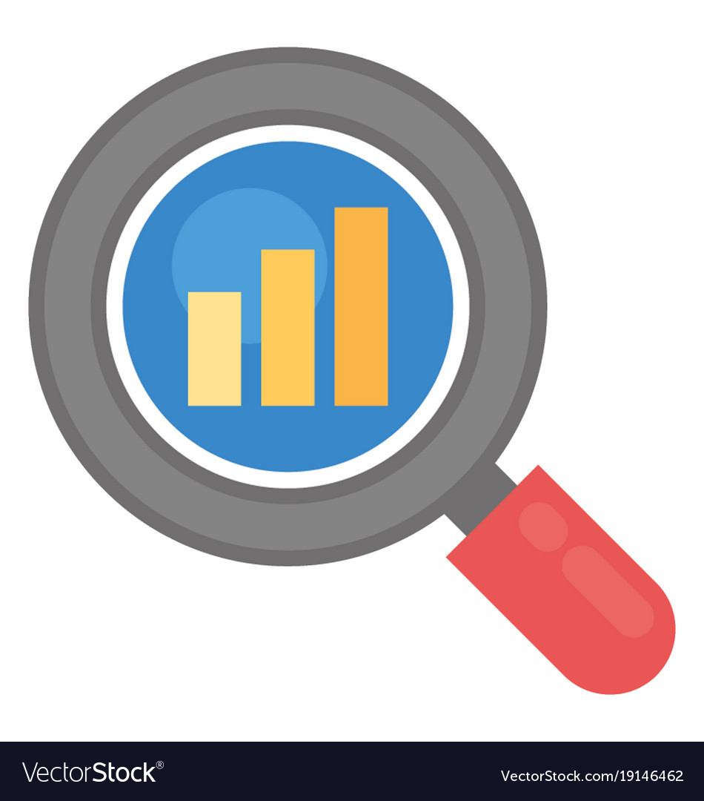
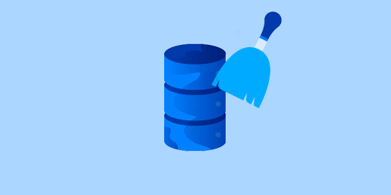
Data Transform
Data analysis is defined as a process of cleaning, transforming, and modeling data to discover useful information for business decision-making. The purpose of Data Analysis is to extract useful information from data and taking the decision based upon the data analysis.
Data cleaning & transforming
“The accuracy of the results of analysis depends on the quality of data”
Clean data is accurate, complete, and in a format that is ready to analyze. Characteristics of clean data include data that are:
Free of duplicate rows/values
Error-free (e.g. free of misspellings)
Relevant (e.g. free of special characters)
The appropriate data type for analysis
Free of outliers (or only contain outliers have been identified/understood),
Follows a “tidy data” structure
Common symptoms of messy data include data that contain:
Special characters (e.g. commas in numeric values)
Numeric values stored as text/character data types
Duplicate rows
Misspellings
Inaccuracies
White space
Missing data
Zeros instead of null values
Data cleaning & transforming tools
In Python, we use many packages to deal with messy data. Such as:
Pandas
Matplotlib
Datacleaner
PrettyPandas
Scrubadub
Numpy

Slide 20
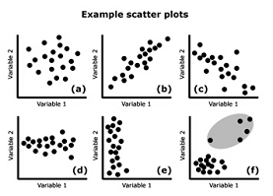
Data Analysis
Data analysis is defined as a process of cleaning, transforming, and modeling data to discover useful information for business decision-making. The purpose of Data Analysis is to extract useful information from data and taking the decision based upon the data analysis.
Exploratory Analysis
“Embrace the data visually before diving further”
The objective of this step is to understand the main characteristics of the data. This analysis is generally done using visualizing tools. Performing an Exploratory analysis helps us:
to understand causes of an observed event
to understand the nature of the data we are dealing with
assess assumptions on which our analysis will be based
to identify the key features in the data needed for the analysis
Graphical Techniques:Scatter plots, box plots, histograms
Quantitative techniques: Mean, median, Mode, Standard deviation

Slide 21
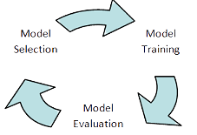
Data Modeling
Data analysis is defined as a process of cleaning, transforming, and modeling data to discover useful information for business decision-making. The purpose of Data Analysis is to extract useful information from data and taking the decision based upon the data analysis.
Model Generation & Validation
“Select-Train-Evaluate”
This step involves extracting features from the data and feeding them into the machine learning algorithms to build a model. Model is the solution proposed for the problem statement. This step involves: Model selection, model training and model evaluation.
Model selection: Based on the type of business problem we are dealing, a model will be built. For example,if the objective of the analysis is to predict a future event, we need to build a Regression model for prediction.
Model Training: After selecting the Model for the analysis, the entire dataset is divided into 2 parts – Training data & Test Data. 3/4th of the entire data will be fed as input to the Model Algorithms.
Model Evaluation: Once the model is built. The next step is to test the model & validate it. The data used for testing the model is the remaining 1/3rd of the dataset in the previous step.

Slide 22
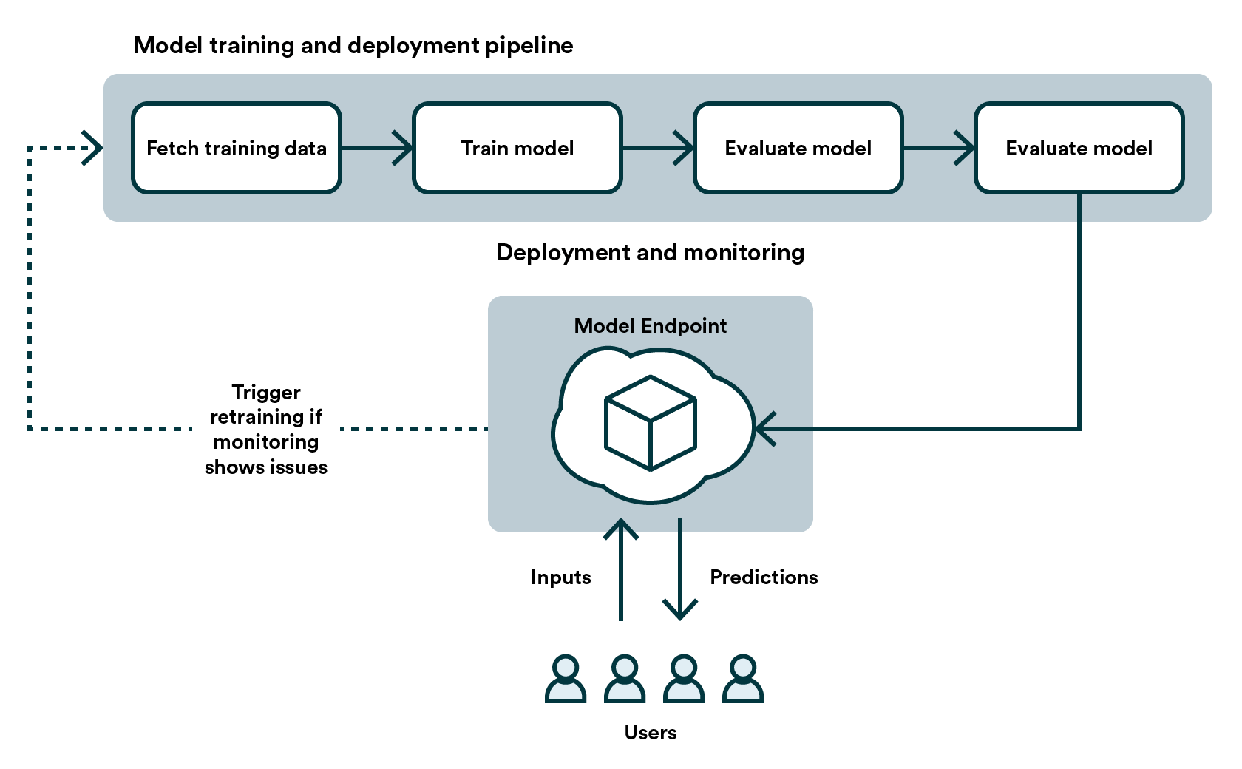
Data Deployment
The concept of deployment in data science refers to the application of a model for prediction using a new data. Depending on the requirements, the deployment phase can be as simple as generating a report or as complex as implementing a repeatable data science process.
Building a model is generally not the end of the project. Even if the purpose of the model is to increase knowledge of the data, the knowledge gained will need to be organized and presented in a way that the customer can use it. Depending on the requirements, the deployment phase can be as simple as generating a report or as complex as implementing a repeatable data science process. In many cases, it will be the customer, who will carry out the deployment steps. For example, a credit card company may want to deploy a trained model or set of models to quickly identify transactions, which have a high probability of being fraudulent. However, even if the analyst will not carry out the deployment effort it is important for the customer to understand up front what actions will need to be carried out in order to actually make use of the created models.
Operationalize a model
After you have a set of models that perform well, you can operationalize them for other applications to consume. Depending on the business requirements, predictions are made in real time or on a batch basis. To deploy models, you expose them with an open API interface. The interface enables the model to be easily consumed from various applications, such as:
Online websites
Spreadsheets
Dashboards
Line-of-business applications
Back-end applications
There are multiple factors to consider when
determining how to deploy a machine learning
model. These factors include:
how frequently predictions should be generated
whether predictions should be generated
for a single instance at a time or a batch of instances
the number of applications that will access the model
the latency requirements of these applications

Slide 23


Data Transformation
Model Training & Development
Model Inference
Data Labelling
(Labelbox, Snorkel,
Scale, Sagemaker)
Data Sources
(Data lake +
Data Warehouse + Streaming engine)
Dataflow Automation
(Apache Airflow)
Query Engines
(Presto, Hive)
Feature Server
(Cassandra)
Feature Store
(Tecton)
Data Science Libraries
(Spark, Pandas, NumPy, Dask)
Model Registry
(MLflow, Sagemaker)
Batch Predictor
(Spark)
Compiler
(TVM)
Online Model Server
(TF Serving, Ray Serve, Seldon)
Data science Platform
(Jupyter, Databricks, Domino, Sagemaker, DataRobot, H2O, Colab, Deepnote, Noteable)
Experiment Tracking
(Weights and Biases, Comet, MLflow)
Model Monitoring
(Fiddler,Arthur, Arize)
Clients
ML Framework
(Scikit-learn, XGBoost, MLlib)
DL Framework
(TensorFlow, Keras, PyTorch, H2O, Hugging Face)
Visualization
(Tensorboard, Fiddler)
Model Tuning
(Sigopt, hyperopt, Ray Tune)
RL Libraries
(Gym, Dopamine, openAI Baselines, Keras RL)
Distributed Processing
(Labelbox, Snorkel,
Scale, Sagemaker)

